Slide 1
Visual ChatGPT & HuggingGPT
Huangzhao Zhang
zhang_hz@pku.edu.cn

Slide 2
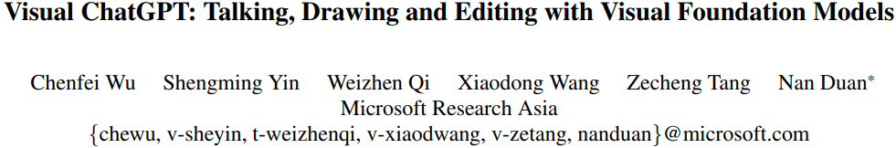

Slide 3
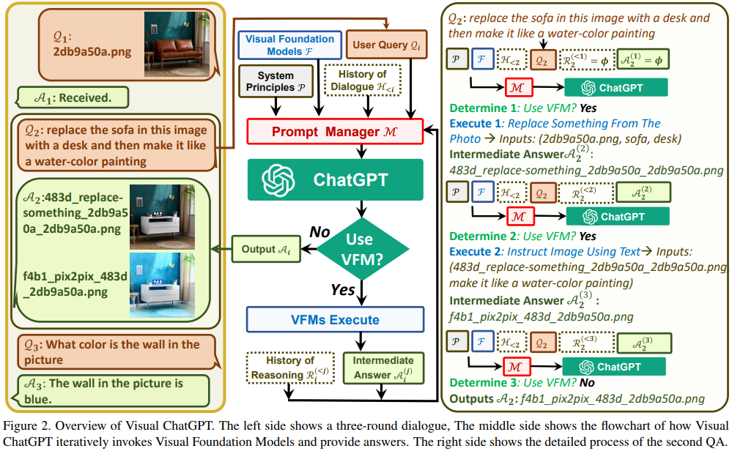
Visual ChatGPT

Slide 4
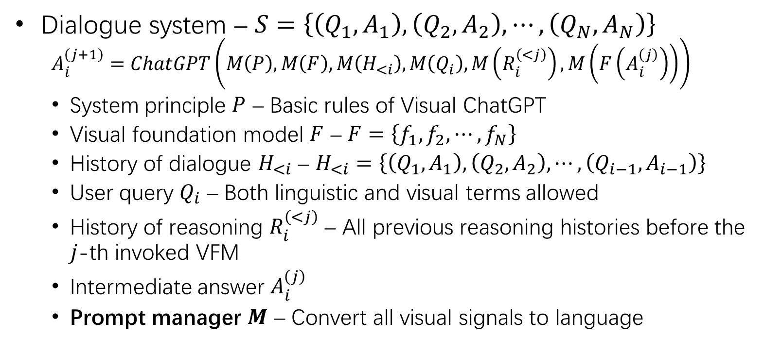
Visual ChatGPT (2)
Dialogue system – $S=\left\{\left(Q_{1},A_{1}\right),\left(Q_{2},A_{2}\right),⋯,\left(Q_{N},A_{N}\right)\right\}$
$$A_{i}^{\left(j+1\right)}=ChatGPT\left(M\left(P\right),M\left(F\right),M\left(H_{<i}\right),M\left(Q_{i}\right),M\left(R_{i}^{\left(<j\right)}\right),M\left(F\left(A_{i}^{\left(j\right)}\right)\right)\right)$$
System principle $P$ – Basic rules of Visual ChatGPT
Visual foundation model $F$ – $F=\left\{f_{1},f_{2},⋯,f_{N}\right\}$
History of dialogue $H_{<i}$ – $H_{<i}=\left\{\left(Q_{1},A_{1}\right),\left(Q_{2},A_{2}\right),⋯,\left(Q_{i−1},A_{i−1}\right)\right\}$
User query $Q_{i}$ – Both linguistic and visual terms allowed
History of reasoning $R_{i}^{\left(<j\right)}$ – All previous reasoning histories before the $j$-th invoked VFM
Intermediate answer $A_{i}^{\left(j\right)}$
Prompt manager $M$ – Convert all visual signals to language

Slide 5
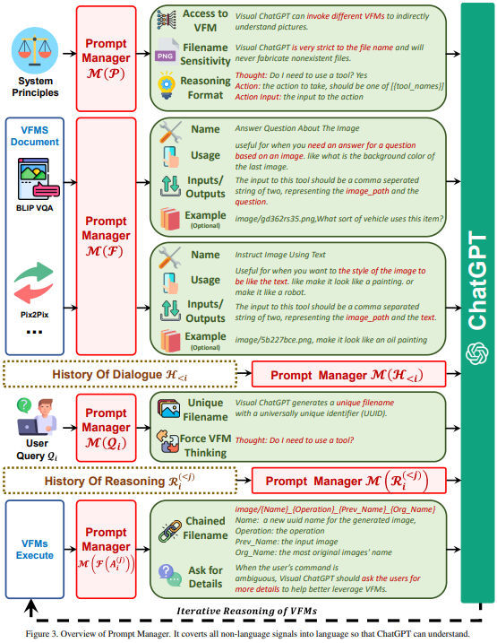
Prompt Manager

Slide 6
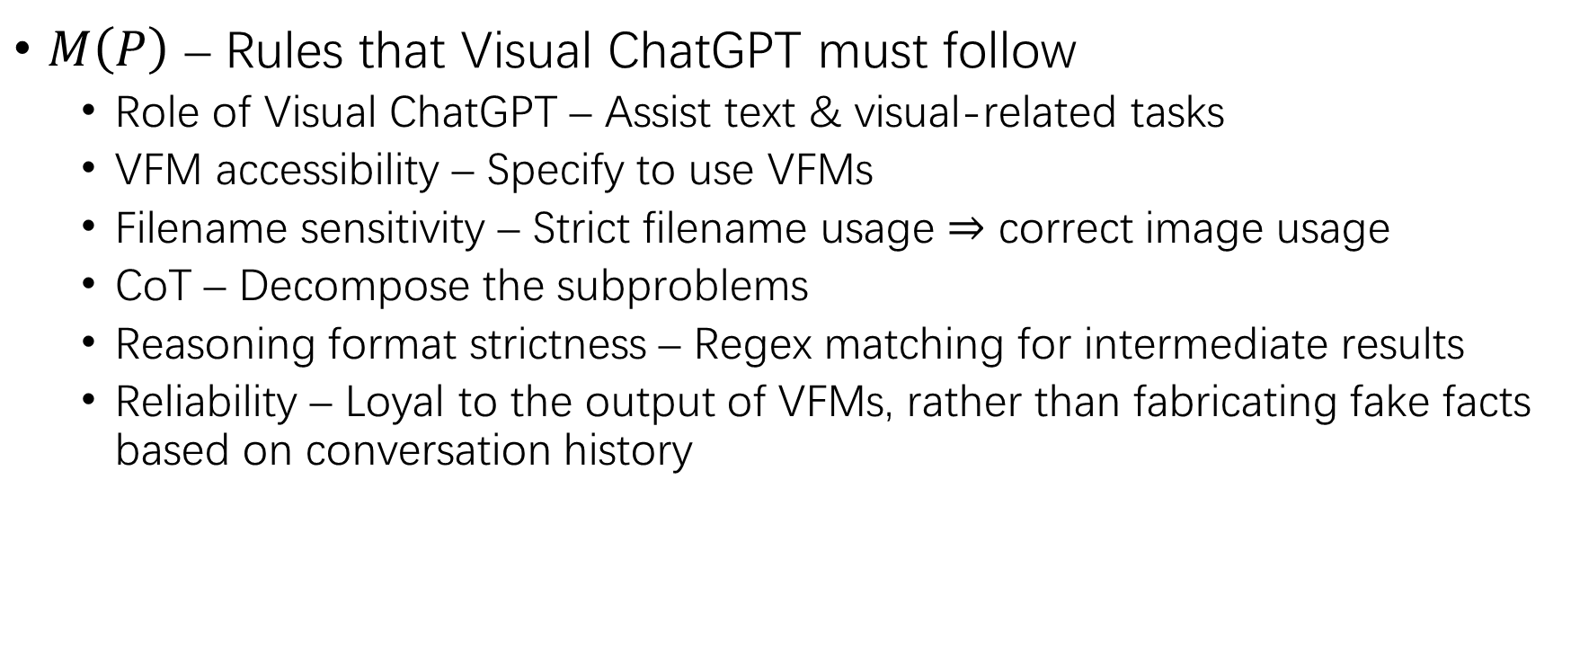
Prompt Managing of System Principles
$M\left(P\right)$ – Rules that Visual ChatGPT must follow
Role of Visual ChatGPT – Assist text & visual-related tasks
VFM accessibility – Specify to use VFMs
Filename sensitivity – Strict filename usage $⇒$ correct image usage
CoT – Decompose the subproblems
Reasoning format strictness – Regex matching for intermediate results
Reliability – Loyal to the output of VFMs, rather than fabricating fake facts based on conversation history

Slide 7
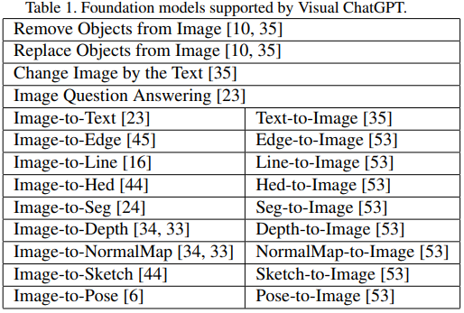
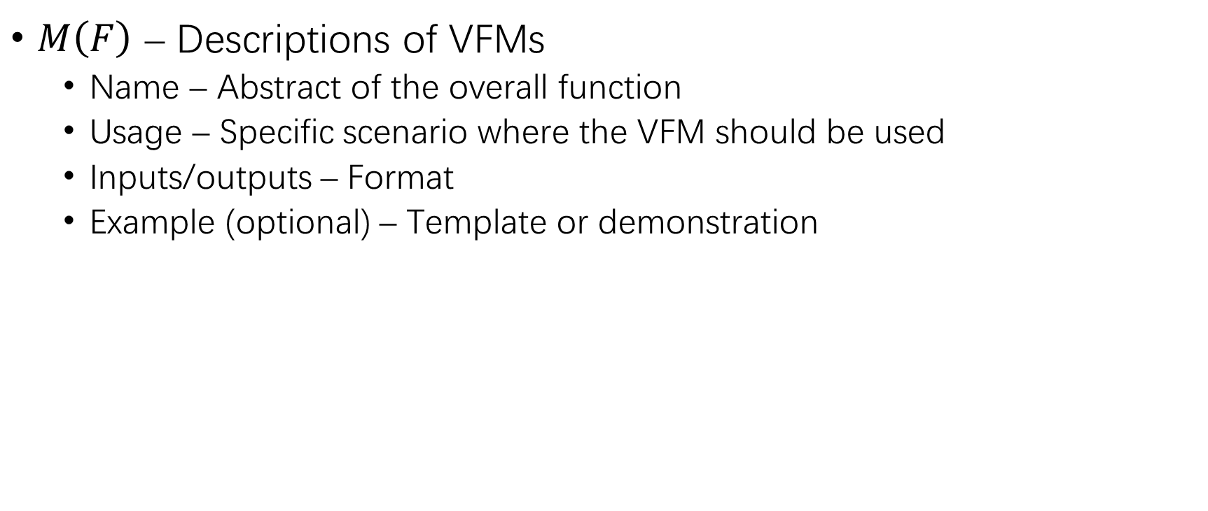
Prompt Managing of VFMs
$M\left(F\right)$ – Descriptions of VFMs
Name – Abstract of the overall function
Usage – Specific scenario where the VFM should be used
Inputs/outputs – Format
Example (optional) – Template or demonstration

Slide 8
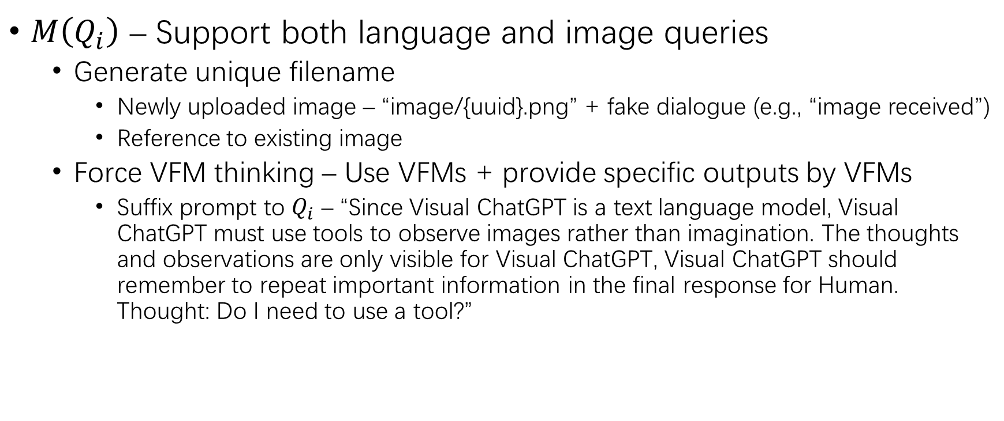
Prompt Managing of User Query
$M\left(Q_{i}\right)$ – Support both language and image queries
Generate unique filename
Newly uploaded image – “image/{uuid}.png” + fake dialogue (e.g., “image received”)
Reference to existing image
Force VFM thinking – Use VFMs + provide specific outputs by VFMs
Suffix prompt to $Q_{i}$ – “Since Visual ChatGPT is a text language model, Visual ChatGPT must use tools to observe images rather than imagination. The thoughts and observations are only visible for Visual ChatGPT, Visual ChatGPT should remember to repeat important information in the final response for Human. Thought: Do I need to use a tool?”

Slide 9
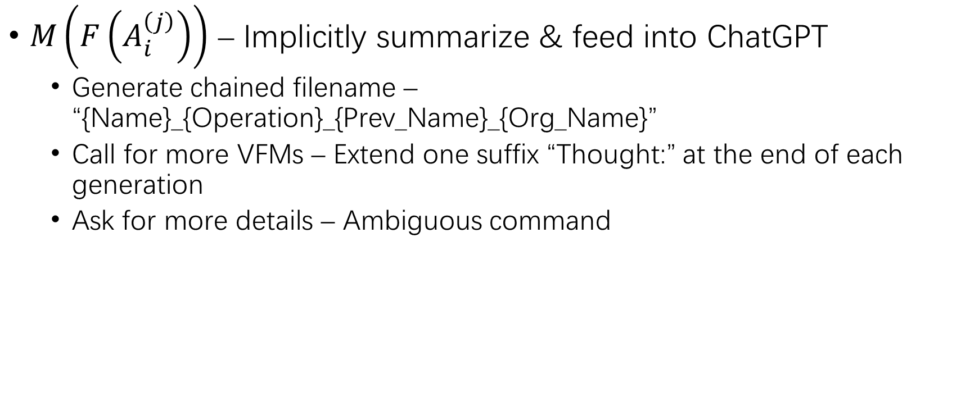
Prompt Managing of VFM Outputs
$M\left(F\left(A_{i}^{\left(j\right)}\right)\right)$ – Implicitly summarize & feed into ChatGPT
Generate chained filename – “{Name}_{Operation}_{Prev_Name}_{Org_Name}”
Call for more VFMs – Extend one suffix “Thought:” at the end of each generation
Ask for more details – Ambiguous command

Slide 10
Experiment Setting
LLM – ChatGPT text-davinci-003
VFM – 22 models
Deployment – 4 Nvidia V100 GPUs
Chat history – 2,000
Excessive token – Truncation

Slide 11
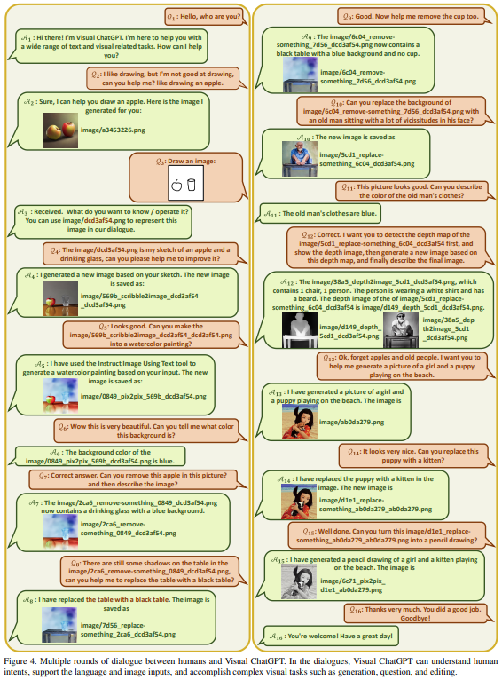
Case Study
16-round multi-modal dialogue

Slide 12
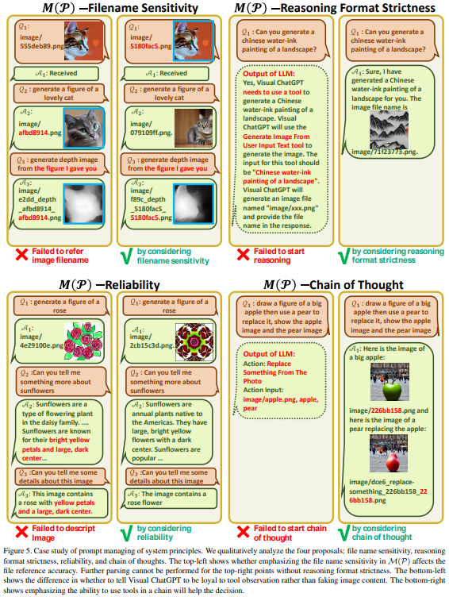
Case Study (2)
System principle
File name
Reasoning format
Reliability
CoT

Slide 13
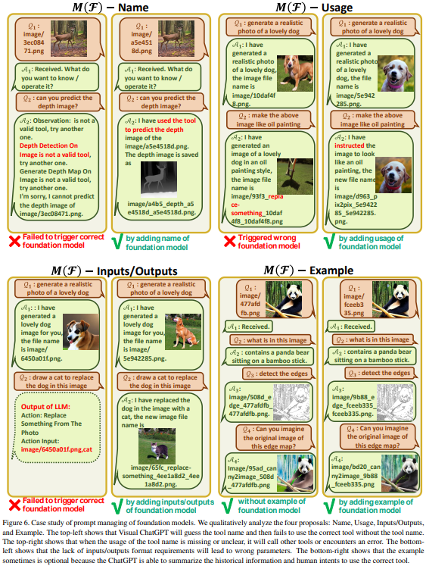
Case Study (3)
VFM
Name
Usage
Inputs/Outputs
Example

Slide 14
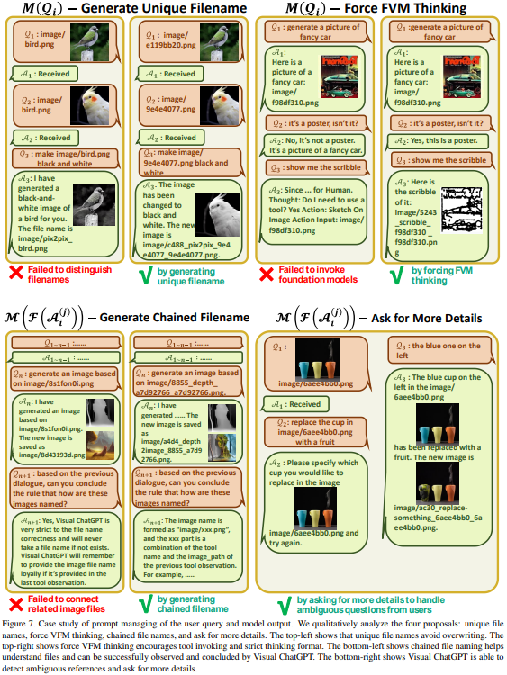
Case Study (4)
User query
Generate unique filename
Force FVM thinking
VFM outputs
Generate chained filename
Ask for more details

Slide 15
Limitation
Dependence on ChatGPT & VFMs
Heavy prompt engineering
Limited real-time capabilities
Token length limitation
Security & privacy – plug & unplug VFMs

Slide 16
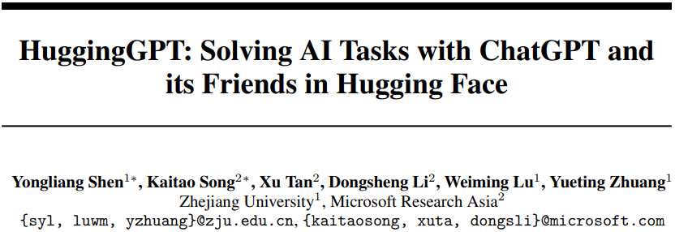

Slide 17
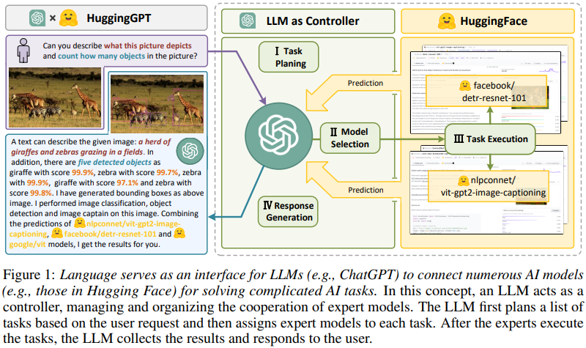
HuggingGPT
Master-slave
Master – e.g., ChatGPT
Slave – HuggingFace model
Pipeline
Task planning
Model selection
Task execution
Response generation

Slide 18
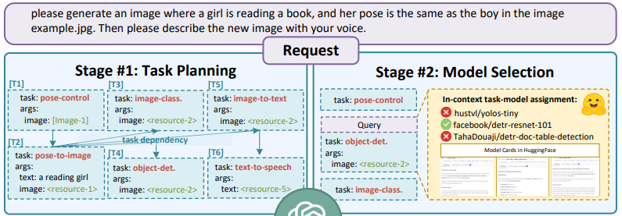
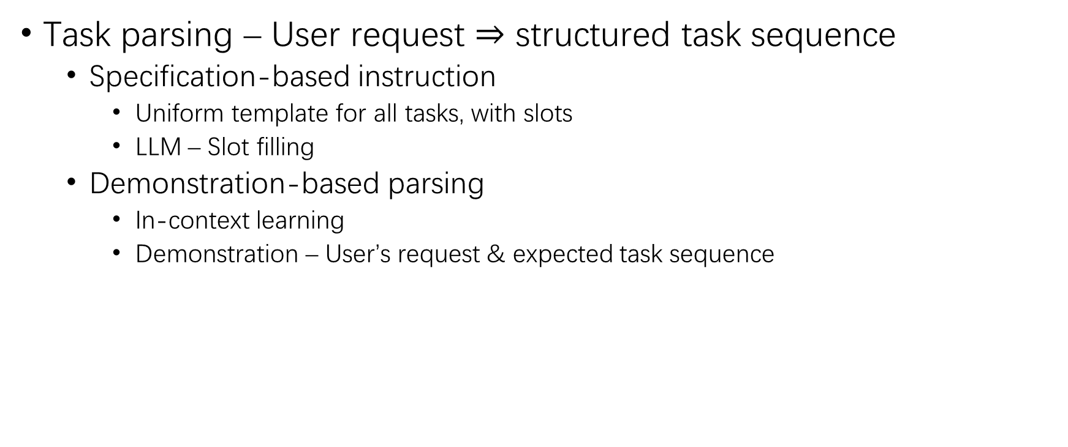
Task Planning
Task parsing – User request $⇒$ structured task sequence
Specification-based instruction
Uniform template for all tasks, with slots
LLM – Slot filling
Demonstration-based parsing
In-context learning
Demonstration – User’s request & expected task sequence

Slide 19
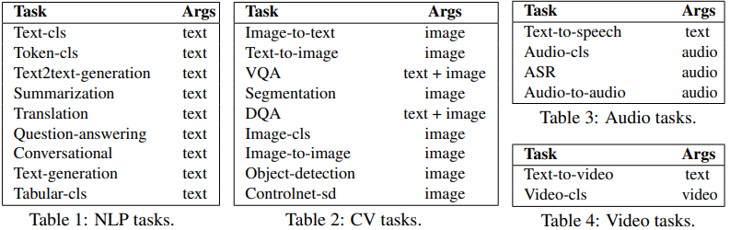
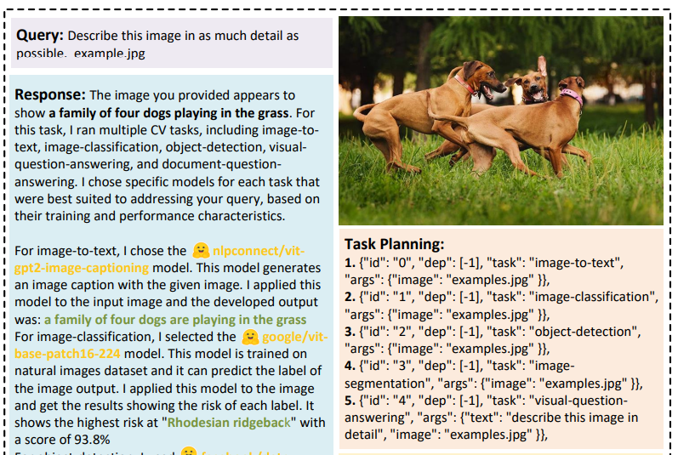
Task Planning (2)
Task template – Four slots for task parsing
Task ID
Task type – Language, visual, video, audio
Task dependency – Pre-requisite tasks
Task argument – List of required arguments for task execution

Slide 20
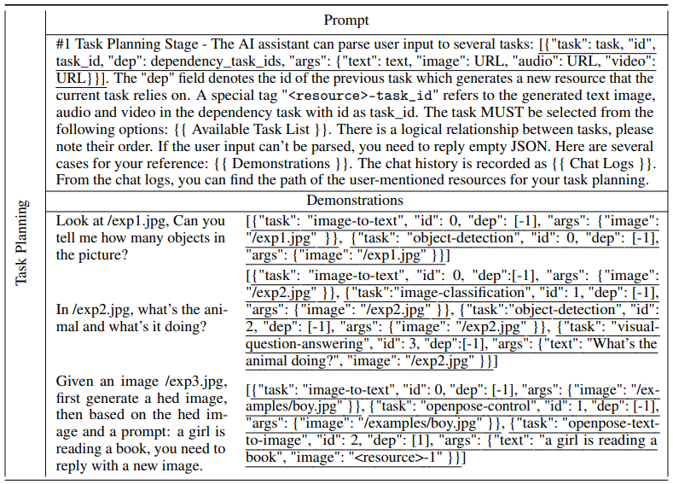
Task Planning (3)

Slide 21
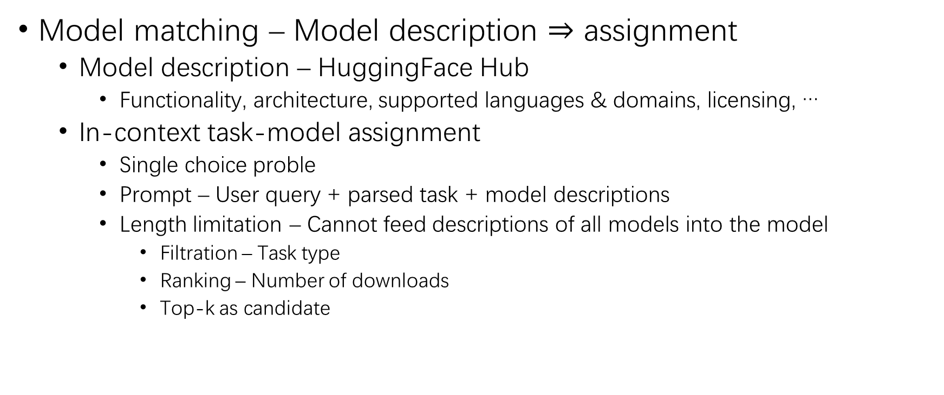
Model Selection
Model matching – Model description $⇒$ assignment
Model description – HuggingFace Hub
Functionality, architecture, supported languages & domains, licensing, …
In-context task-model assignment
Single choice proble
Prompt – User query + parsed task + model descriptions
Length limitation – Cannot feed descriptions of all models into the model
Filtration – Task type
Ranking – Number of downloads
Top-k as candidate

Slide 22
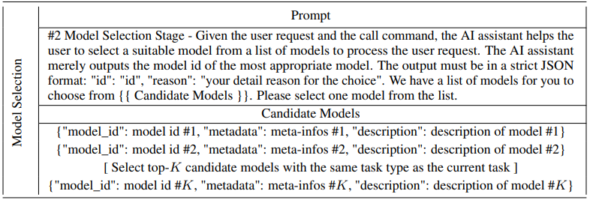
Model Selection (2)

Slide 23
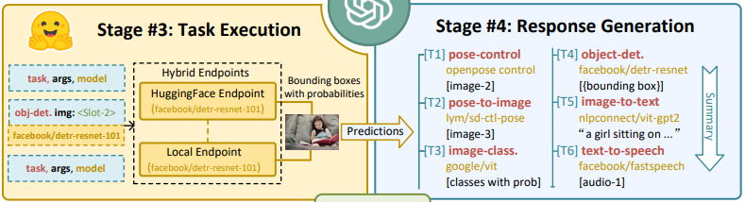
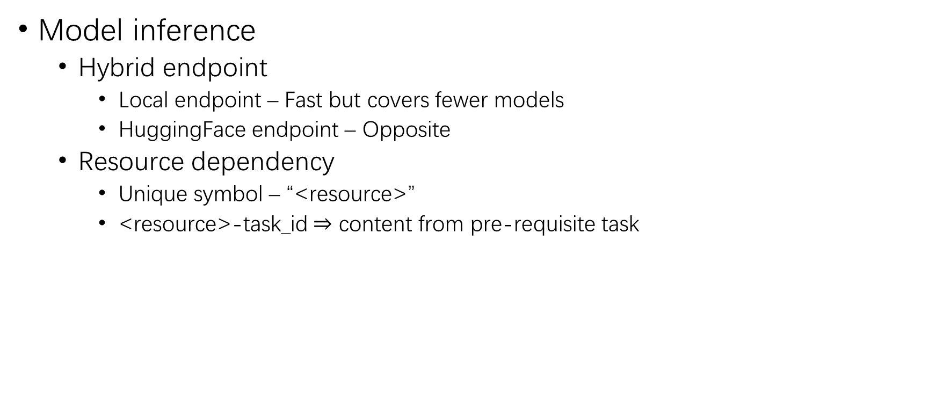
Task Execution
Model inference
Hybrid endpoint
Local endpoint – Fast but covers fewer models
HuggingFace endpoint – Opposite
Resource dependency
Unique symbol – “<resource>”
<resource>-task_id $⇒$ content from pre-requisite task

Slide 24
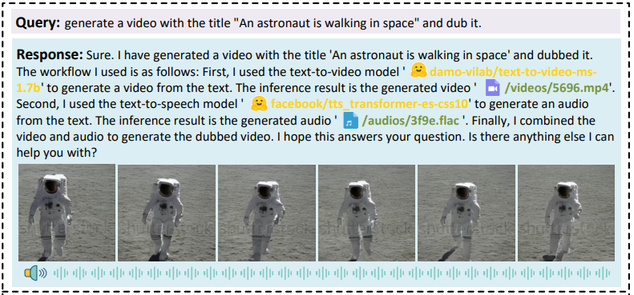
Response Generation
Response
Previous information – Task planning, model selection, and task execution. The inference results appear in a structured format.
Summarization – Active response + aggregated inference results

Slide 25
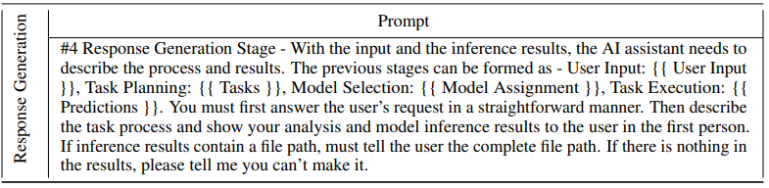
Response Generation (2)

Slide 26
Experiment Setting
LLM – gpt-3.5-turbo & text-davinci-003
Stable output – Temperature = 0

Slide 27
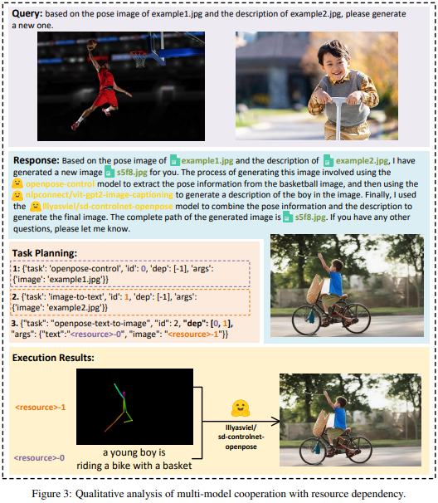
Qualitative Result
Resource dependency

Slide 28
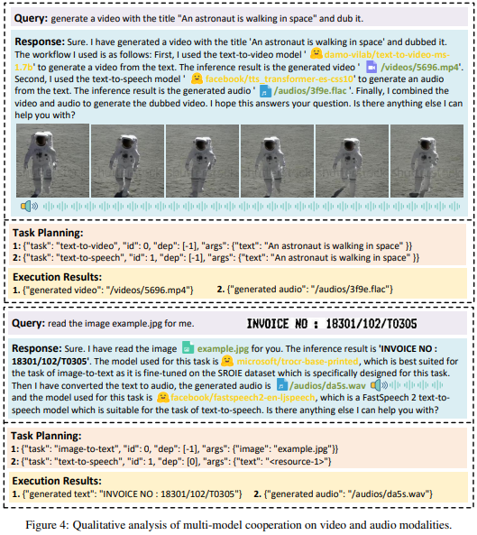
Qualitative Result (2)
Conversational ability on audio and video modalities
Parallel generation
Serial generation

Slide 29
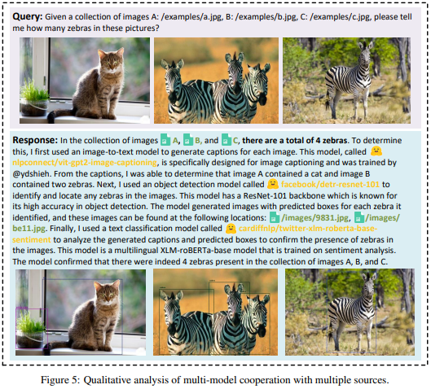
Qualitative Result (3)
Integration of multiple inputs
Simple reasoning

Slide 30
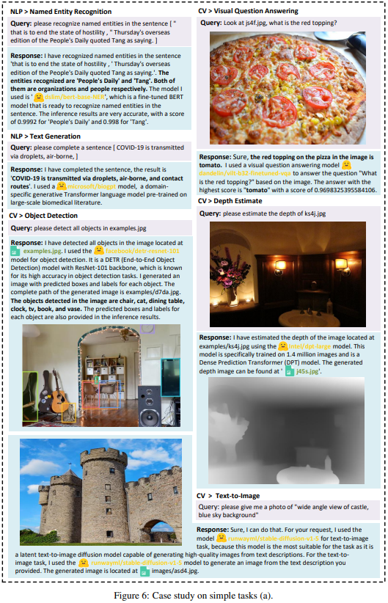
Case Study
Simple task

Slide 31
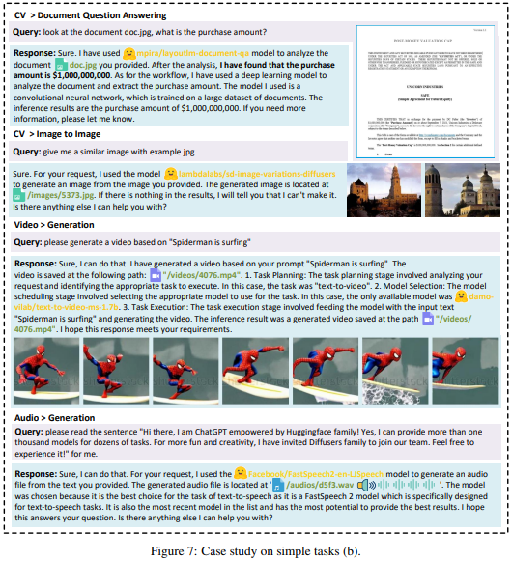
Case Study (2)
Simple task

Slide 32
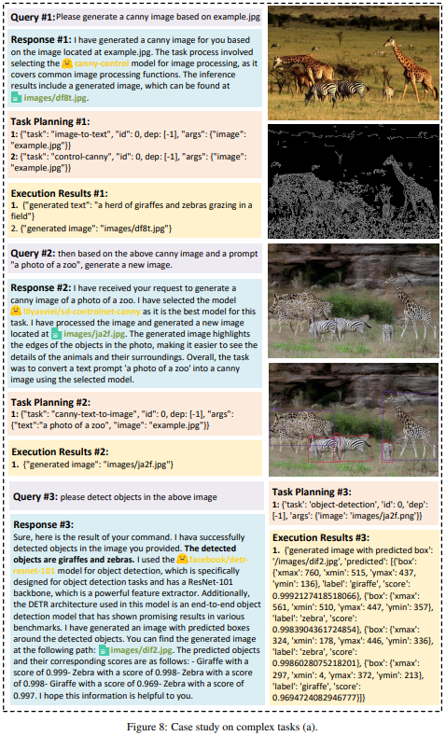
Case Study (3)
Complex task
Multi-round conversation

Slide 33
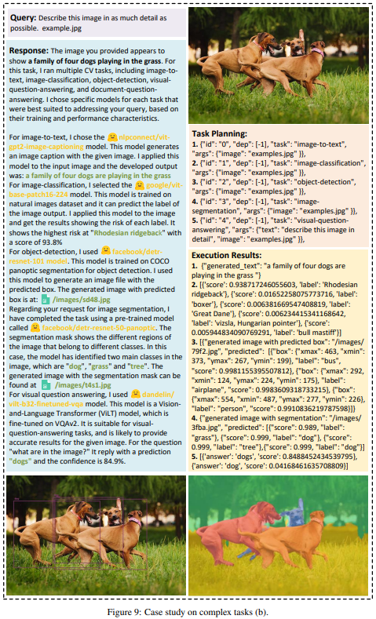
Case Study (4)
Complex task
Complex task parsing

Slide 34
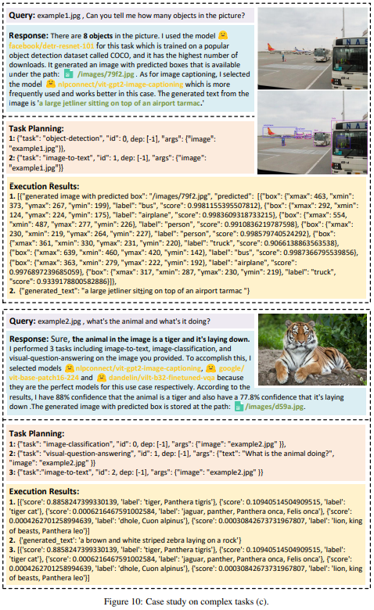
Case Study (5)
Complex task
Multiple explicit tasks in user’s request

Slide 35
Limitation
Efficiency
Length limitation
System stability
Model rebellion
Uncontrollable state of the expert model

Slide 36
THANK YOU!

